Slide 1
John F. Kennedy Democrat 1961-1963

Slide 2
JFK’s Inaugural Speech
“Let the word go forth from this time and place, to friend and foe alike, that the torch has been passed to a new generation of Americans, born in this century, tempered by war, disciplined by hard and bitter peace…
“Let every nation know , whether it wishes us well or ill, that we shall pay any price, bear any burden, meet any hardship, support any friend, oppose any foe to assure the survival and the success of liberty..”
“And so, my fellow Americans, ask not what your country can do for you, ask what you can do for your country.”

Slide 4
JFK’s Domestic Policies
The New Frontier- name of domestic policies, uses Best and Brightest in his cabinet.
Peace Corps American volunteer to help poor nations build schools, wells etc.-cold war
Space Program- NASA, challenges US scientist to put a man on the moon-cold war
Civil Rights- 1963 asks Congress to pass Civil Rights bill outlawing discrimination in employment.

Slide 6
Cold War Problems
Bay of Pigs April 1961-orders invasion of Cuba by U.S. trained Cuban exiles. It Failed. JFK is embarrassed.
Berlin Wall August 1961 wall construction begins- concrete not just barbed wire- Ultimate symbol of cold war.
Cuban Missile Crisis October 1962 U.S. discovers Soviets placed missiles. 13 day stand off- JFK gets Khrushchev to remove missiles.

Slide 7
1959 Fidel Castro leads a Communist Revolution in Cuba

Slide 8
Bay of Pigs failed invasion- 200 killed 1,200 captured

Slide 9
98 people died trying to escape

Slide 10
96 miles

Slide 11
Cuban Missile Crisis 13 Days on the brink of Nuclear War

Slide 17
Increases Military Advisors to 16,000 South Vietnam to help fight communism

Slide 18
November 22, 1963 JFK Assassinated

Slide 19
First Bullet to hit, second shot

Slide 20
JFK is shot twice

Slide 21
Lee Harvey Oswald JFK’s Assassin

Slide 22
School Book Depository Building Dallas, TX

Slide 23
6th Floor

Slide 24
Two Days after killing JFK Oswald is shot and Killed by Jack Ruby

Slide 25
1964 The Warren Commission Concludes Oswald Acted Alone

Slide 26
Inspired By King, many young people form their own non-violent groups to fight Jim Crow

Slide 27
Sit-ins

Slide 28
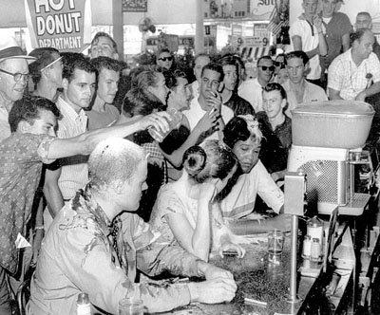
Sit-ins

Slide 29
Freedom Rides

Slide 31
James Meredith

Slide 32
Medgar Evers

Slide 33
“Segregation today, segregation tomorrow, and segregation forever” Alabama Governor George Wallace

Slide 34
March on Washington 1963 200,000+ gather to support JFK’s Civil Rights Proposals

Slide 35
“I Have a Dream” Speech

Slide 36
Civil Rights Legislation
Civil Rights Act 1964- outlawed discrimination in the work place-EOE
Voting Rights Act 1965- outlawed literacy tests for voting.
24th Amendment-outlawed poll taxes.

Slide 37
An Alternative to King

Slide 38
February 21, 1965

Slide 39
1966 The Black Panthers Form

Slide 40
Black Panther Organizers
Huey Newton
Bobby Seale

Slide 41
The Ten Point Program was as follows:
We want power to determine the destiny of our black and oppressed communities' education that teaches us our true history and our role in the present day society.
We want completely free health care for all black and oppressed people.
We want an immediate end to police brutality and murder of black people, other people of color, all oppressed people inside the United States.
We want an immediate end to all wars of aggression.
We want full employment for our people.
We want an end to the robbery by the capitalists of our Black Community.
We want decent housing, fit for the shelter of human beings.
We want decent education for our people that exposes the true nature of this decadent American society.
We want freedom for all black and oppressed people now held in U. S. Federal, state, county, city and military prisons and jails. We want trials by a jury of peers for all persons charged with so-called crimes under the laws of this country.
We want land, bread, housing, education, clothing, justice, peace and people's community control of modern technology

Slide 42
“I Have Seen The Promised Land”

Slide 43
Memphis, Tennessee

Slide 45
James Earl Ray

Slide 47
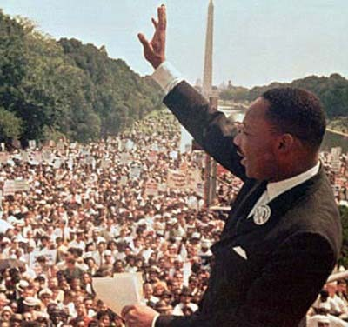
U2 Lyrics - Pride (In The Name Of Love)
One man come in the name of love One man come and go One come he to justify One man to overthrow In the name of love What more in the name of love In the name of love What more in the name of love One man caught on a barbed wire fence One man he resist One man washed on an empty beach. One man betrayed with a kiss In the name of love What more in the name of love In the name of love What more in the name of love (nobody like you...) Early morning, April 4 Shot rings out in the Memphis sky Free at last, they took your life They could not take your pride In the name of love What more in the name of love In the name of love What more in the name of love In the name of love What more in the name of love...

Slide 48
Black Civil Rights Movement Inspires Other Groups

Slide 49
Black Civil Rights Movement Inspires Other Groups

Slide 50
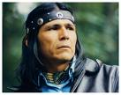
Black Civil Rights Movement Inspires Other Groups
Dennis Banks

Slide 51
June 5, 1968 Another Kennedy Is Assassinated

Slide 52
Lyndon B. Johnson Democrat 1963-1969

Slide 53
LBJ’s Domestic Policies
The Great Society- domestic policies in which he declared a War on Poverty.
Creates Medicaid and Medicare- medical benefits for the poor and elderly.
This War on Poverty was never funded as much as LBJ wanted due to the money spent on the Vietnam War.

Slide 54
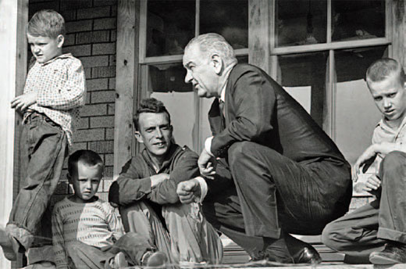
LBJ’s War on Povety

Slide 56
2008 HHS Poverty Guidelines
Persons in Family or Household | 48 Contiguous States and D.C. | Alaska | Hawaii
1 | $10,400 | $13,000 | $11,960
2 | 14,000 | 17,500 | 16,100
3 | 17,600 | 22,000 | 20,240
4 | 21,200 | 26,500 | 24,380
5 | 24,800 | 31,000 | 28,520
6 | 28,400 | 35,500 | 32,660
7 | 32,000 | 40,000 | 36,800
8 | 35,600 | 44,500 | 40,940
For each additional person, add | 3,600 | 4,500 | 4,140

Slide 57
LBJ and The Vietnam War

Slide 58
Divided at the 17th Parallel

Slide 59
Nationalist/Communist Leader of North Vietnam Ho Chi Minh

Slide 60
LBJ and The Vietnam War
LBJ will Escalate U.S. involvement in the war by increasing the amount of U.S. Soldiers fighting in Vietnam.
The Gulf of Tonkin Resolution-1964 -passed by Congress, this allowed LBJ to increase the amount of soldiers w/out limits-550,000+ by the end of his presidency.
These soldiers were fighting the North Vietnamese Army and the Viet Cong(South Vietnamese Guerillas)

Slide 61
LBJ and The Vietnam War
Why did he Escalate?/Fight the War?
Containment
and
Domino Theory
LBJ didn’t want to be the President who “lost Vietnam” the way Truman “lost China”

Slide 62
LBJ and The Vietnam War
New Weapons of War:
Agent Orange-Chemical that killed dense jungle vegetation.
Napalm-petroleum based bombs that set fire to surrounding areas.
Hueys-helicopters that dropped soldiers at LZ’s that often were Hot.

Slide 63
Agent Orange

Slide 64
Napalm

Slide 65
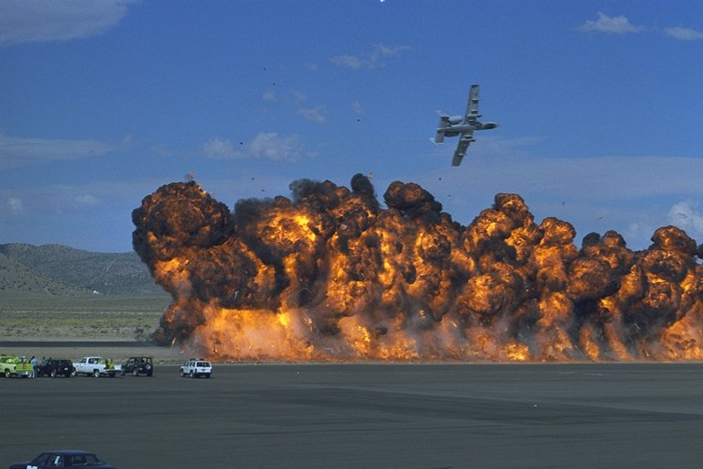

Slide 66
UH-1 Helicopters “Hueys”

Slide 67
Landing Zone

Slide 68
Air Cavalry

Slide 69
“Grunts”

Slide 70
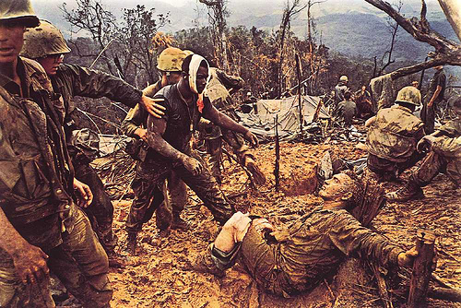

Slide 71
Booby Traps

Slide 73
Tunnels

Slide 76
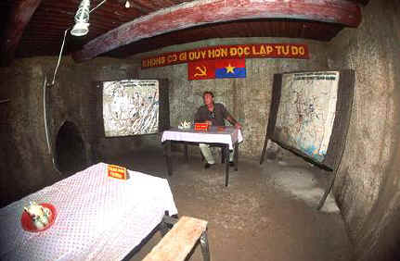

Slide 78
Operation Rolling Thunder

Slide 79
Doves vs. Hawks

Slide 80
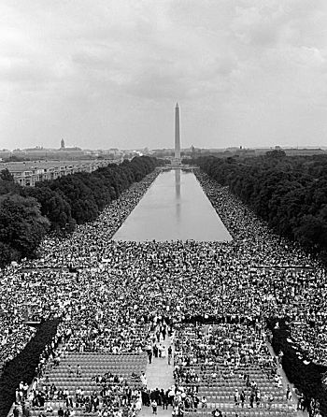
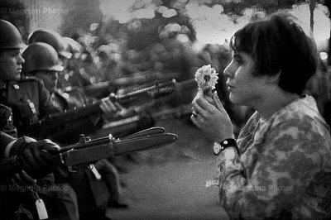
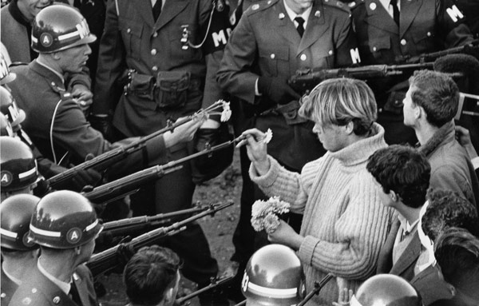
Stop The Draft Week October 16-22, 1967- “Unjust War”
50,000+ March on Washington , D.C.

Slide 81
The Television War
Each night the TV news gave Body Counts, how many American died that day. The war becomes more unpopular.
As more died, LBJ drafted more, saying there was “Light at the end of the tunnel”, meaning the war was almost over and we were winning.
That LBJ and the Military were lying became clear in January of 1968.

Slide 82
The Television War
January 1968- Every major city in South Vietnam was attacked by NVA and VC in what was called the Tet Offensive.
These attacks were televised and proved to be a psychological victory, not a military victory, because most Americans saw we were not winning the war! They had been lied to.
Two months later LBJ announced he would not run for another term as president.

Slide 83
Tet Offensive January 1968

Slide 85
Nixon and The Vietnam War
Richard Nixon wanted the South Vietnamese to take over the fighting, he called this Vietnamization.
He promised to greatly reduce the number of U.S. soldiers in Vietnam.-
1969-550,000+ 1972-25,000+
He angers many Americans when he orders attacks of Cambodia and Laos- Ho Chi Minh Trail-Supply line to VC

Slide 86
Ho Chi Minh Trail

Slide 87
Kent St. Killings
The invasions of Cambodia and Laos led to protests on college campuses around the nation.
In Ohio, 4 students were killed by National Guard Troops sent to stop the protests.

Slide 88
May 4, 1970

Slide 89
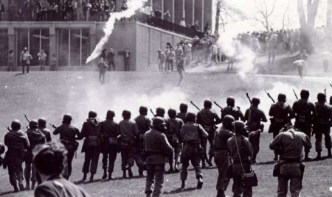
Ohio-Crosby,Stills,Nash+Young
Tin soldiers and Nixon's comin'. We're finally on our own. This summer I hear the drummin'. Four dead in Ohio. Gotta get down to it. Soldiers are gunning us down. Should have been done long ago. What if you knew her and Found her dead on the ground? How can you run when you know? Na, na, na, na, na, na, na, na. Na, na, na, na, na, na, na, na. Na, na, na, na, na, na, na, na. Na, na, na, na, na, na, na, na. Gotta get down to it. Soldiers are cutting us down. Should have been done long ago. What if you knew her and Found her dead on the ground? How can you run when you know? Tin soldiers and Nixon's comin'. We're finally on our own. This summer I hear the drummin'. Four dead in Ohio. Four dead in Ohio. Four dead in Ohio

Slide 90
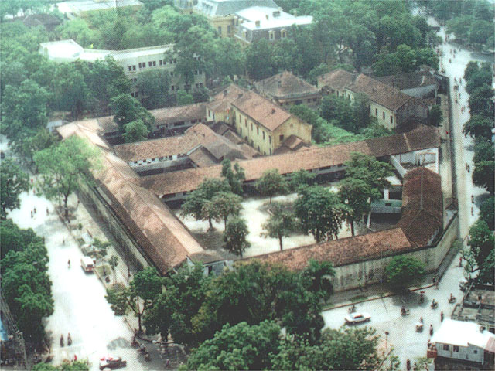
P.O.W’s
Hanoi Hilton

Slide 91
5 Years as a P.O.W

Slide 93
1973 The Last P.O.W.’s are returned Some had been imprisoned for 9 years

Slide 94
Results/Effects
Superior Technology- does not always win wars.
Public Opinion- can change foreign policy- public wanted the war to end.
Caution in involvement- over the next 20yrs. Presidents and Congress would fear “Another Vietnam.”
War Powers Act 1973- Limits these for Presidents-troops sent can only stay 90 days w/out Congress’ permission- Tonkin Resolution reversed.

Slide 95
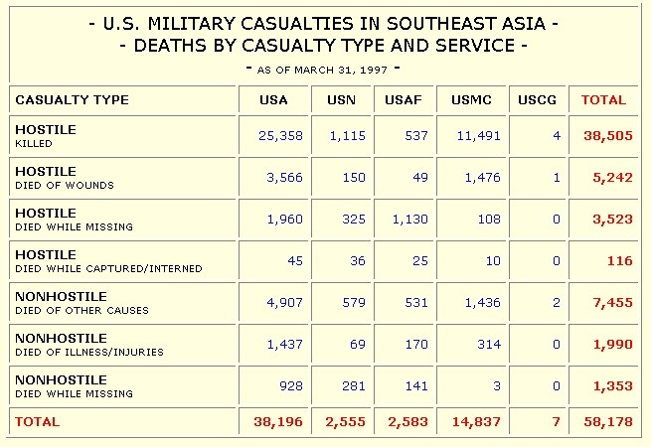

Slide 96
1975 The Last American Military Personnel Evacuate South Vietnam as North Vietnam takes over creating one communist nation.

Slide 97
The Vietnam Memorial Wall 1982 250 ft. Long 58,000+ Names

Slide 98
